Slide 1
A Java Space Odyssey: Fun with Saucers, Lasers, Raspberry Pi’s, and Arduino
Prashanth Gunapalasingam, Frank Ji
Notes:
Introduce ourselves
Ask anyone had a chance to check out the game at the IBM booth
Show video

Slide 2
A journey through space and time
Our mission: To make a conference-ready demo
Notes:
- Ask if anyone knows what Liberty is?
Describe what OpenLiberty is (Liberty is an open-source Java EE 8 compliant application server)

Slide 3
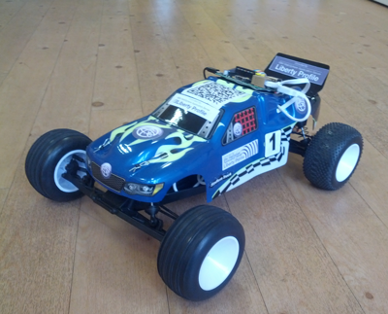
Before it all began…
The Liberty Car
Notes:
- Does anyone remember the car?!
The Liberty Car is a remote controlled car that has a Raspberry Pi with a web application running on a Liberty server controlling it.
For 5 years now, the Liberty Car has served as a fun demo to get people to come to the IBM Booth at conferences. People spot it, come and chat, give it a try, and that leads to having a conversation about our Java, Liberty, and more.

Slide 4
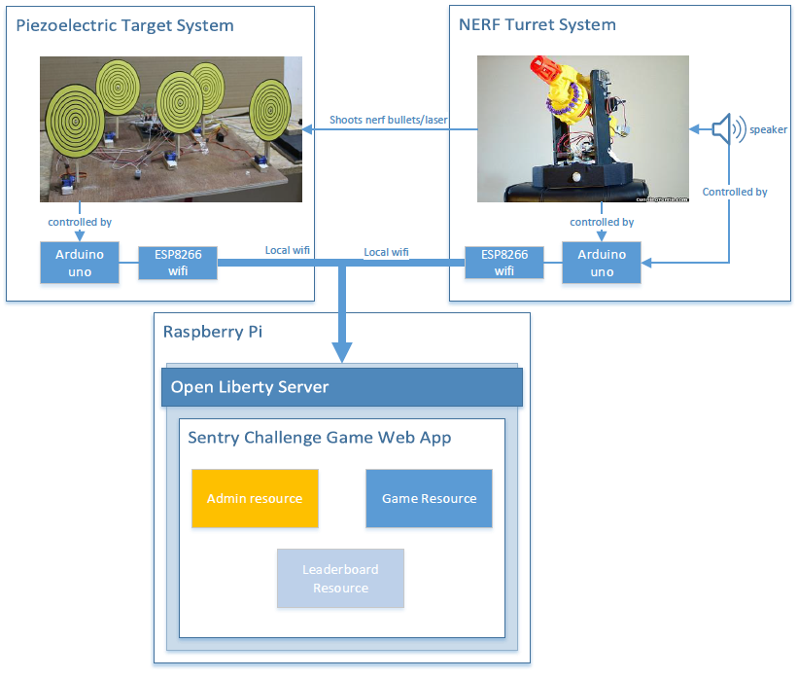
Every journey starts with a single step
Phase 1 – Creating the concept design
Notes:
Objectives:
Demoable at a conference booth, that conference goers can try
Make it fun, like a game
Make use of the latest technologies and cool stuff
Created an IOT application/game

Slide 5
Gearing up!
Phase 2 – Building the demo
What do we need? Where do we start?
Learning curve
Hardware (circuits, soldering, wires, resistors, etc?!)
Arduino, servos, WiFi modules
Connecting software and hardware together
Notes:
- No Experience
- Take apart the gun, connecting several servos together,

Slide 6
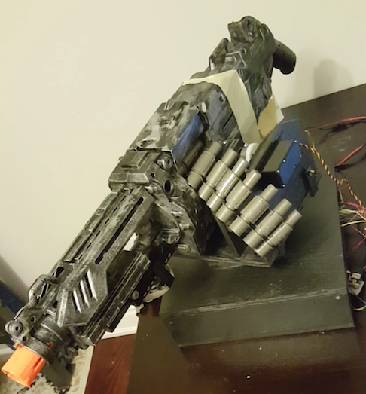
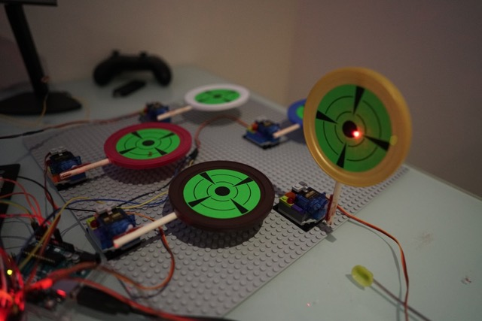
The first prototype
NERF Turret System
Piezoelectric Target System
Notes:
nerf bullets
piezoelectric
lego
control using joystick
web application only keeps track of the score

Slide 7
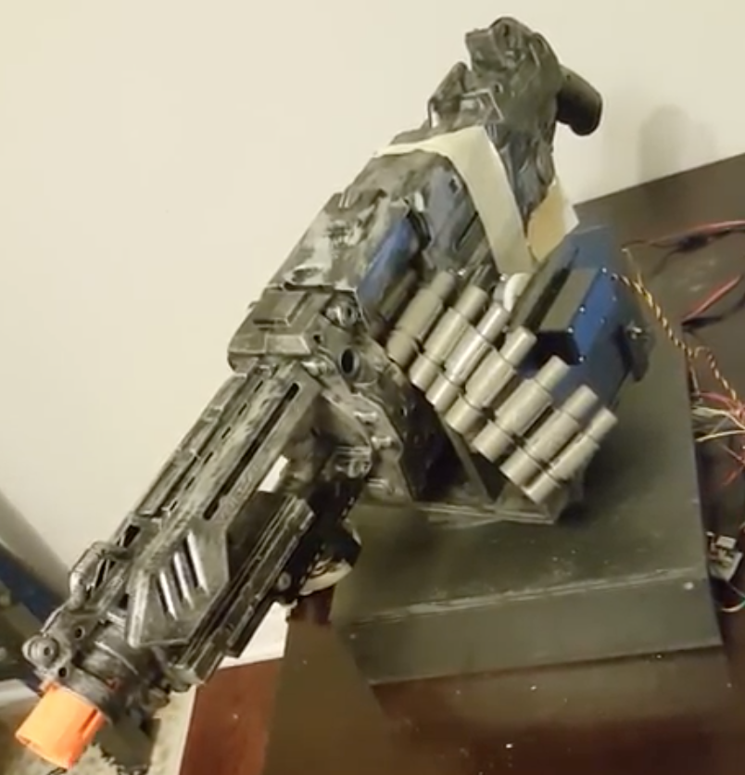
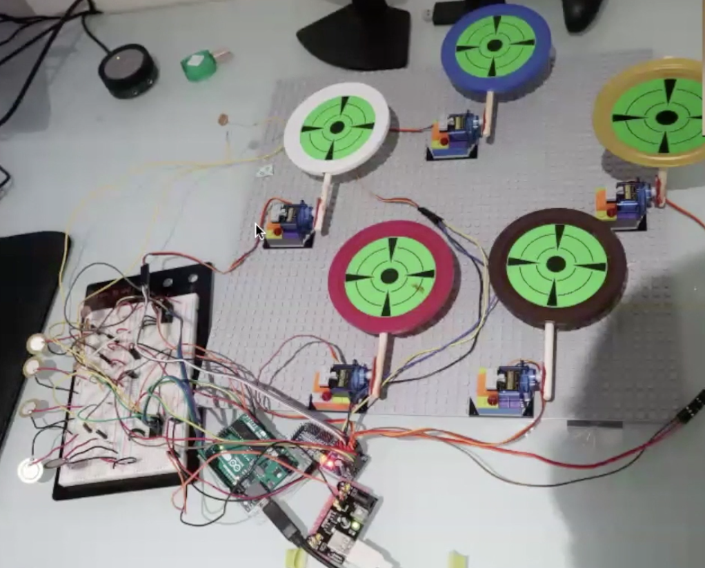
Here comes the speedbumps
NERF Turret System
Looks too realistic, uh oh…
Too big to transport
Targets array
Very fragile
Not portable; fixed length
Messy wiring and circuits
What does the software do?!
Notes:
Who knew flying with nerf guns, would be a challenge
Software only displayed static files

Slide 8
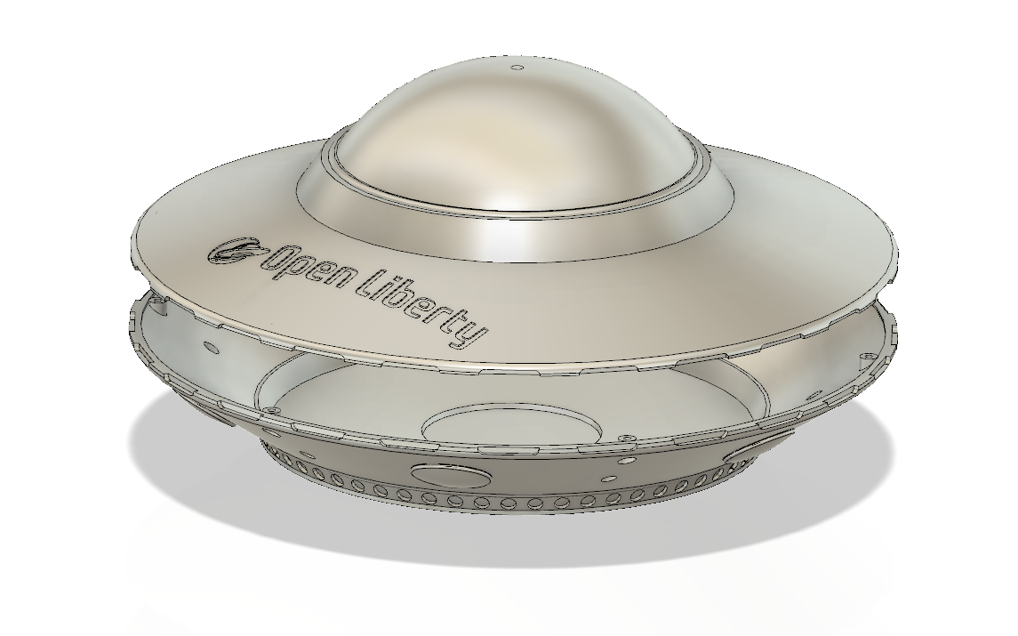
Back to the drawing board
Open Liberty Saucer

Slide 9
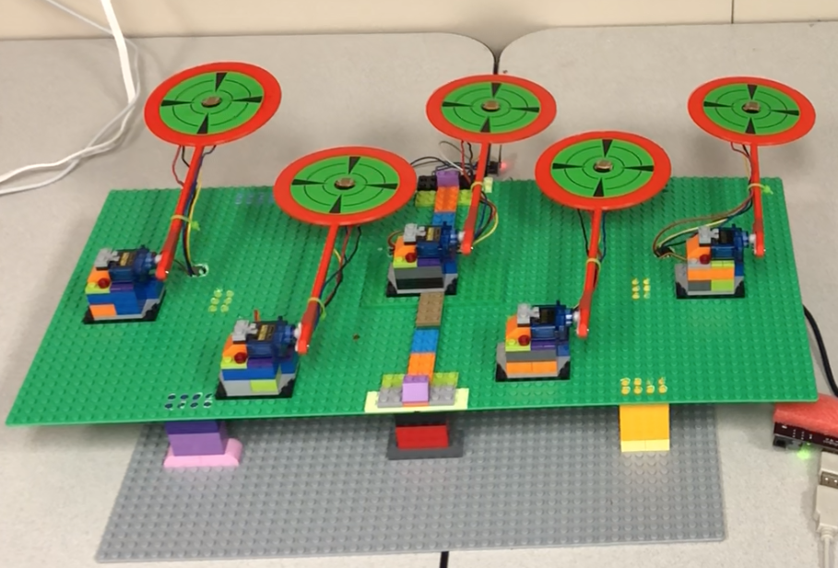
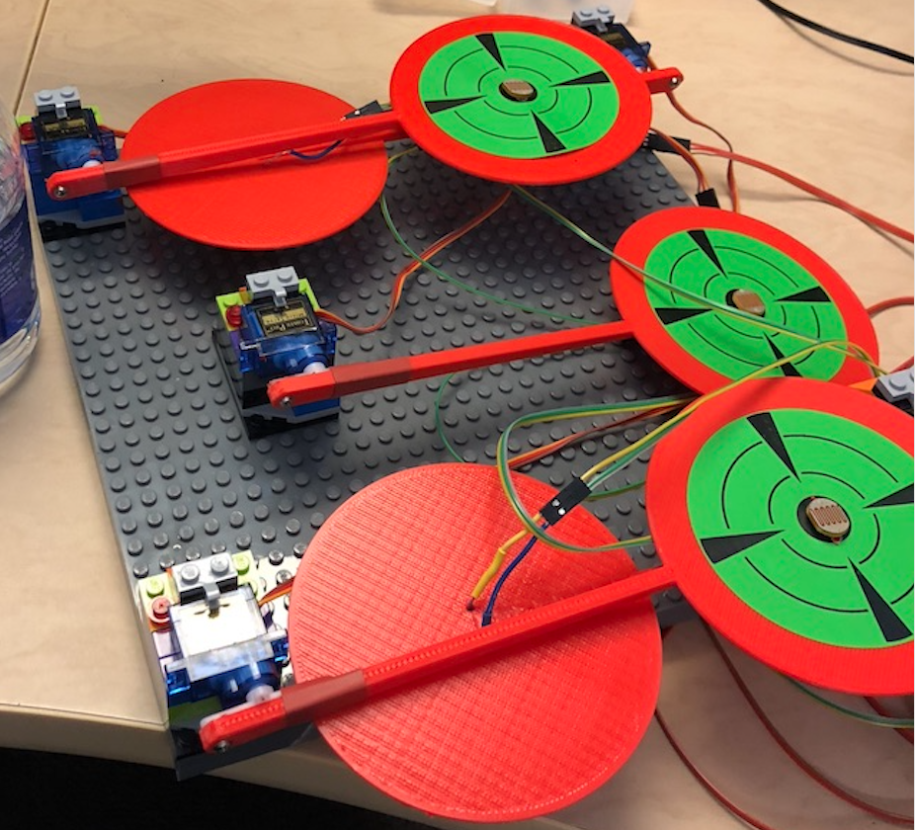
Back to the drawing board
Portable and concise targets system
Notes:
Photo resistor
3d printed

Slide 10
Back to the drawing board
Software comes into play
Communicate with the spaceship/targets via Open Liberty
Microservices architecture
Game Service
Leaderboard service
Admin Service
Containerize the services

Slide 11
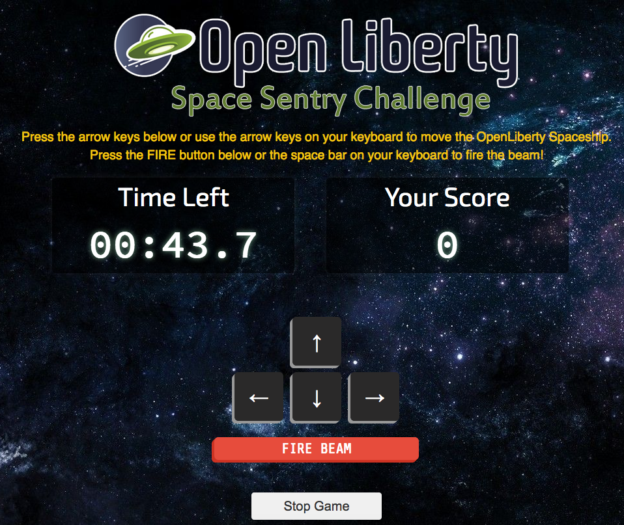
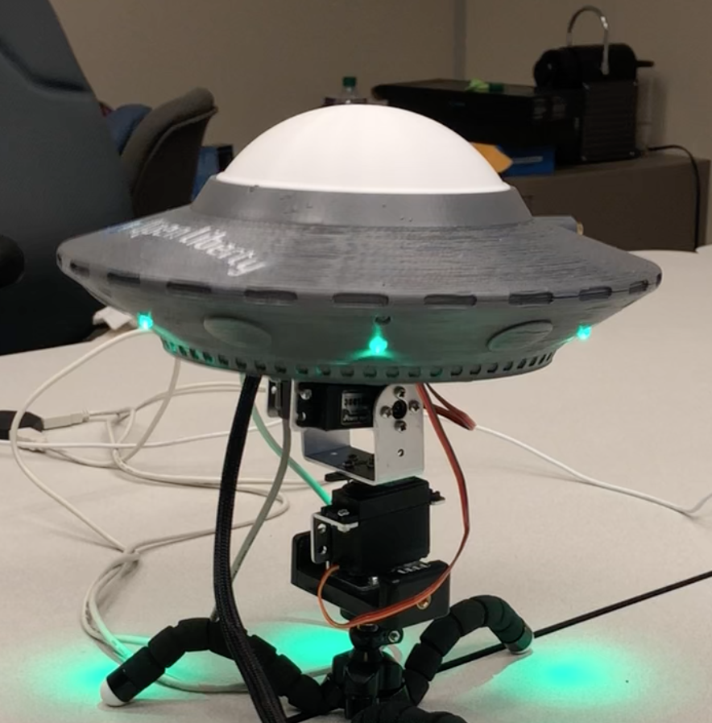
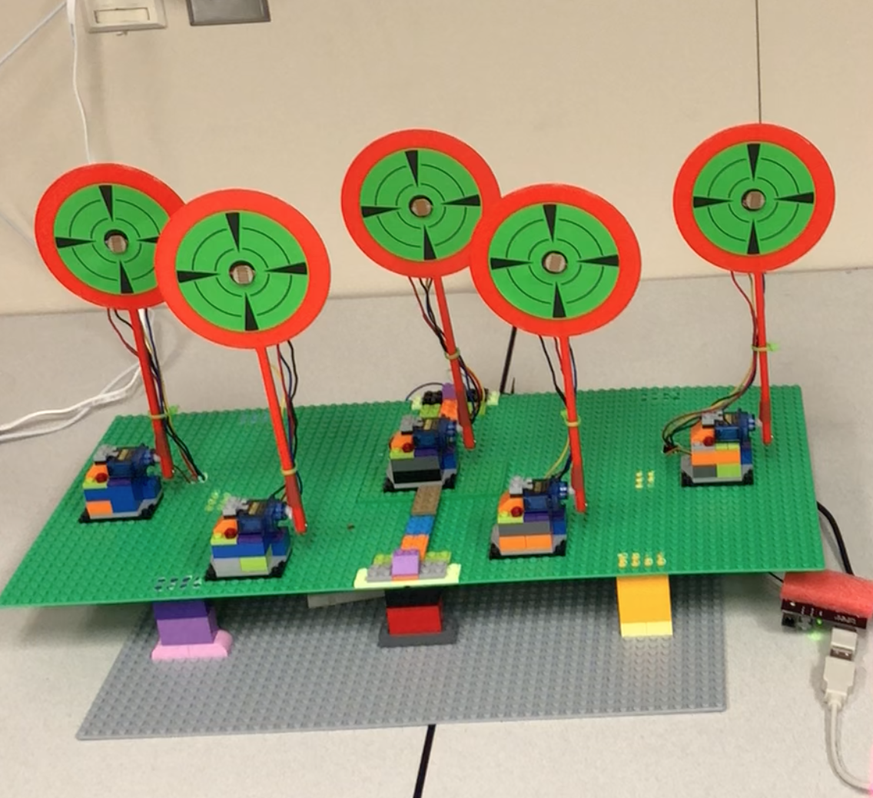
The demo
Created a fun game called the “Open Liberty Space Sentry Challenge”
Notes:
Created game, where the player has 60 seconds to shoot down the targets
Got great feedback, R2D2 comments

Slide 12
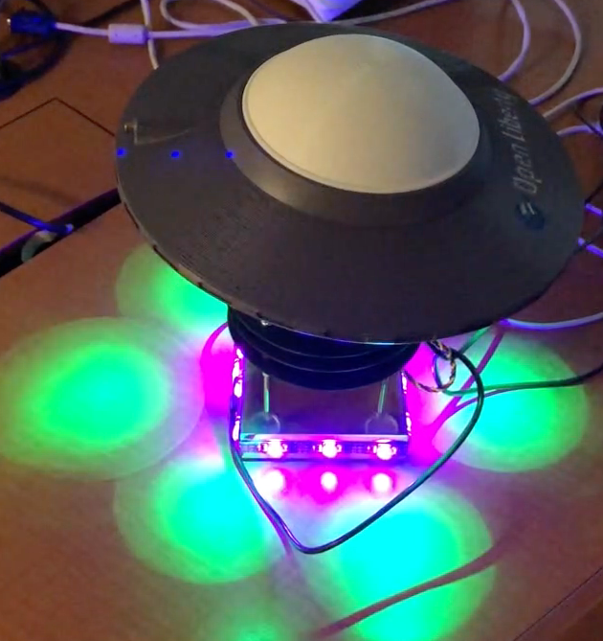
The journey
A rollercoaster ride
Ups and downs, but a lot of excitement and fun!
Became our hobby and passion!
Many technical challenges were learnt and faced
Notes:
- Ask if anyone has any questions

Slide 13
From Circuit to Microservices with Love
A software developer’s diary on building Space Sentry Challenge
Notes:
Challenge faced and solved
Lessons learned

Slide 14
Hello hardware, my old friend..
Prashanth and I both graduated with ECE degree, but….
Imagine hiring a construction company to build a spaceship
Notes:
+ encourage ppl to work on their own Arduino projects

Slide 15
Not all that different
Hardware | Software
Choosing a Development Board | Choosing a language
Learning the pin layout | Learning the language
Choosing parts | Choosing libraries
Wiring | Coding
Rewiring | Refactoring
Short circuit, loose circuit | Exceptions
Taking photos | Github

Slide 16
A ‘Hello World’ circuit
Notes:
1. Describe how the shooting mechanics works
2. Why we have to build this circuit as a starting point

Slide 17
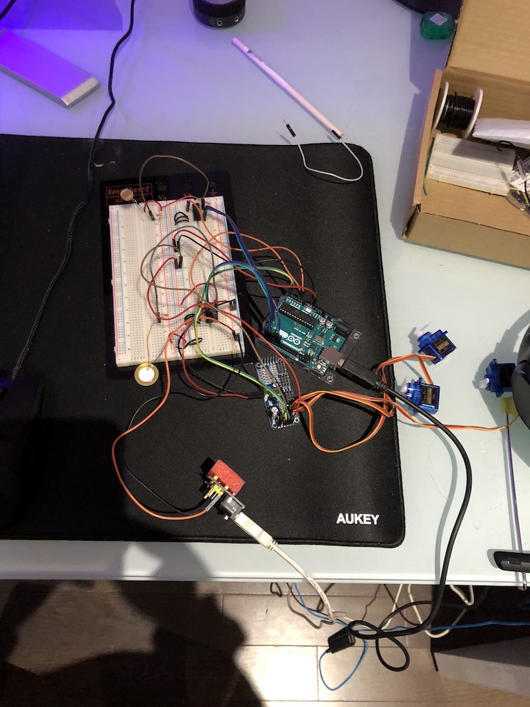
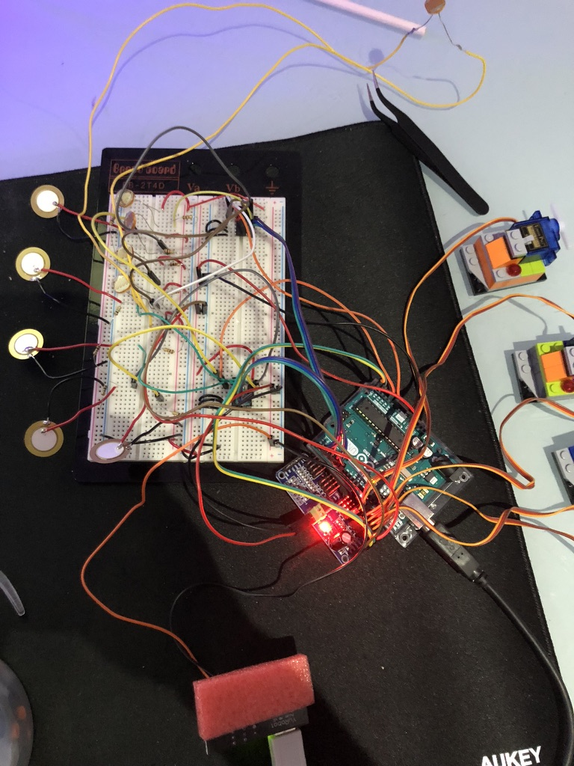
Let’s prototype it!

Slide 18
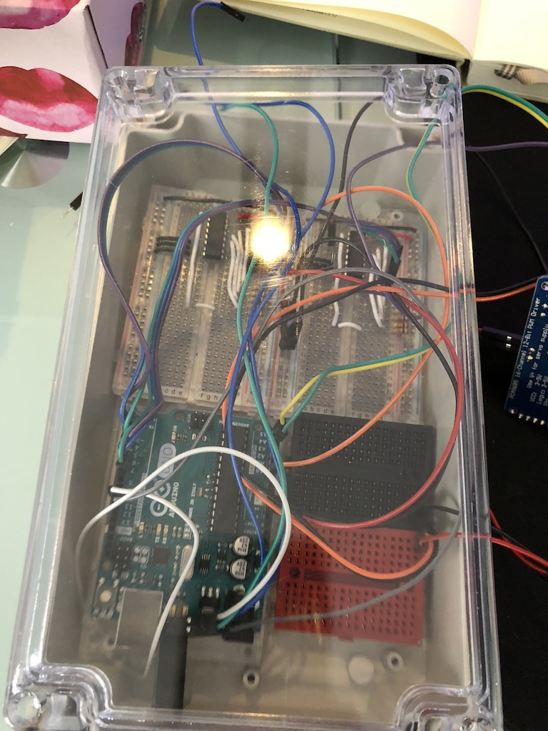
Refactor ( Sorry, I mean rewiring)

Slide 19
Taking Arduino Online
ESP8266 Programmable WiFi module
$5.00 for ESP-01 model
8 pins
Arduino IDE Ready

Slide 20
Connecting Arduino to ESP
ESP as a TCP Relay
Notes:
Factory flashed ESP can only work with AT commands
Lots of garbage characters and delay
+ overview picture then Arduino

Slide 21
Problems Encountered So far
Not enough pins on your dev board
Solution: Multiplexer, PWM Servo Driver
TCP Performance
Solution: disable Nagle’s Algorithm
Mysterious Recoil Effect
Solution: prevent power surge

Slide 22
Blasts into Java (web)sphere (1/3)
Do we really need all these?

Slide 23
Blasts into Java (web)sphere (2/3)

Slide 24
Blasts into Java (web)sphere (3/3)
Time is the key
Eclipse MicroProfile + MongoDB + Open Liberty
Notes:
Open Liberty is MicroProfile 2.0 compliant
Introduce MP in one sentence

Slide 25
Single App Architecture
Notes:
1. Talk about how user interact with the web application
2.

Slide 26
To MS or not to MS..
To microservice or not to microservice - that is the question
It’s already a small service
No immediate benefit
Notes:
Every system overview needs to have more than 1 services to look good

Slide 27
New MS Architecture

Slide 28
A Brave New World
A scale & A skill
New possibilities comes with new challenges
The Twelve-Factor app is the new holy book
Notes:
- Real world implication and reason for using

Slide 29
Works ahead
Current state
Prototype 1
End goal
Modern finish
S.A.S
Won’t survive flight
Not combat ready
Bulky
Disaster recovery
Intimidating
Multi-verse travel
Can’t reach the cloud
Image source: http://marvelcinematicuniverse.wikia.com

Slide 30
Q & A

Slide 31
Thank You!
http://openliberty.io
https://microprofile.io/

